Slide 1
Attention, Transformers
Jian Tang
HEC Montreal
Mila-Quebec AI Institute
Email: jian.tang@hec.ca

Slide 2
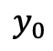
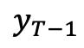
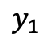
Sequence2Sequence (Encoder-Decoder)
$$y_{0}$$
$$y_{1}$$
$$y_{T−1}$$

Slide 3
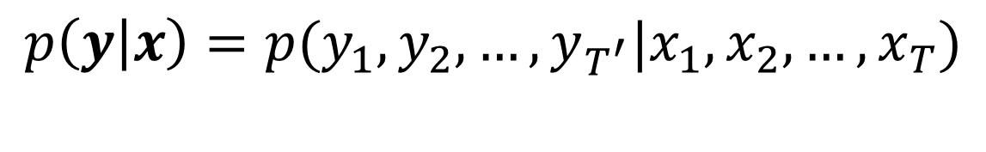
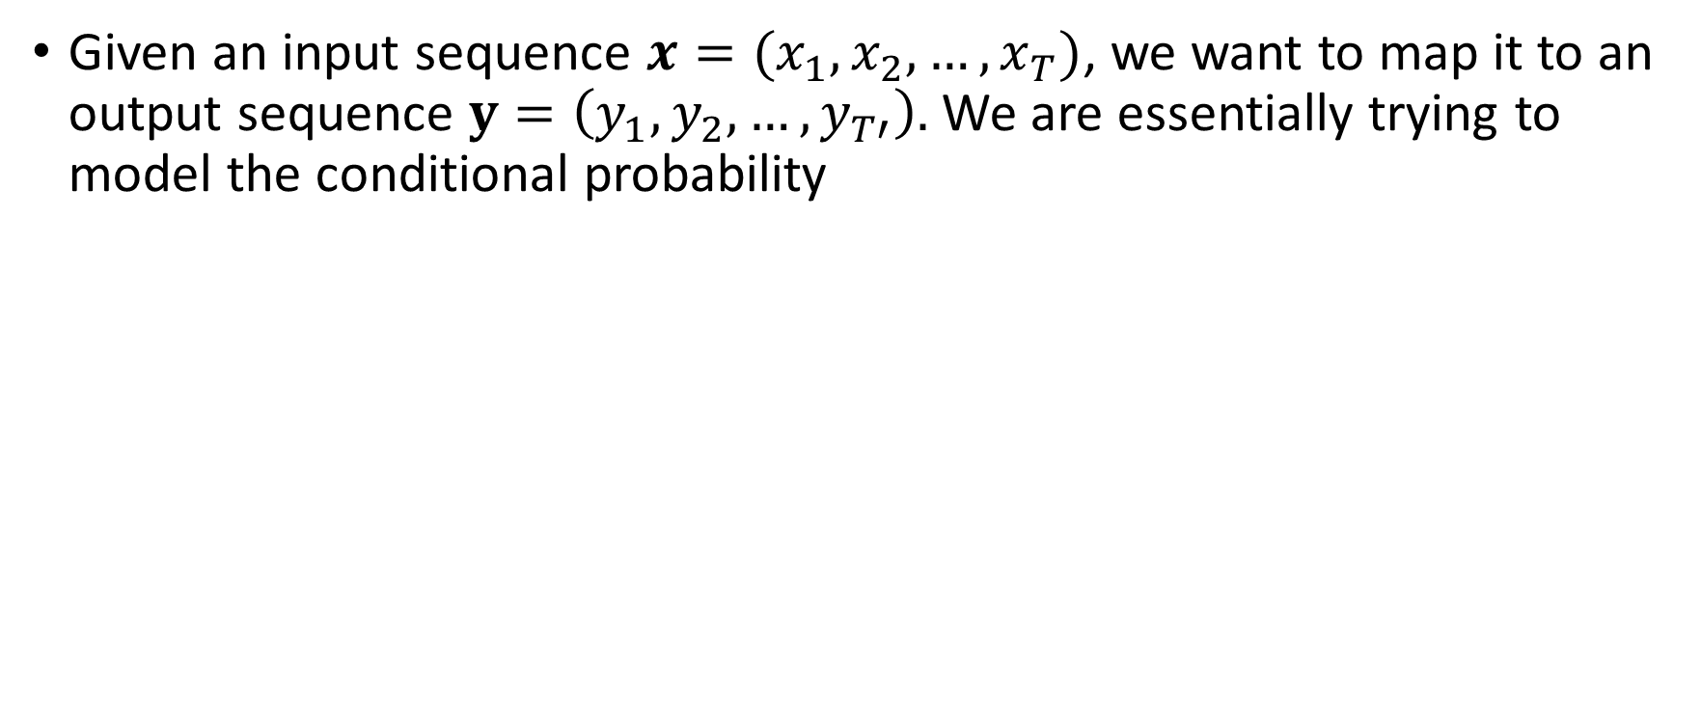
Sequence to Sequence Model
Given an input sequence $x=(x_{1},x_{2}, …, x_{T})$, we want to map it to an output sequence $y=\left(y_{1},y_{2}, …, y_{T′}\right).$ We are essentially trying to model the conditional probability
$$p\left(y | x\right)=p(y_{1},y_{2}, …, y_{T^{′}}|x_{1},x_{2}, …, x_{T})$$

Slide 4
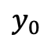
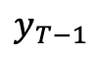
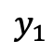
Encoder: one Recurrent Neural Network
C is the last hidden state of input
sequence
summary of the input sequence
$$y_{0}$$
$$y_{1}$$
$$y_{T−1}$$

Slide 5
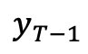
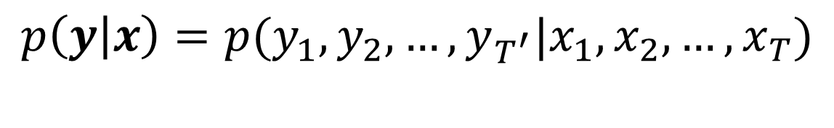

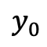
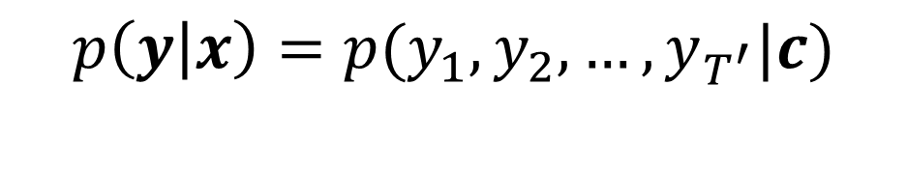
Decoder: another Recurrent Neural Network
Decode the output sequence y based on
the input sequence x
$$y_{0}$$
$$y_{1}$$
$$y_{T−1}$$
$$p\left(y | x\right)=p(y_{1},y_{2}, …, y_{T^{′}}|x_{1},x_{2}, …, x_{T})$$
$$p\left(y | x\right)=p(y_{1},y_{2}, …, y_{T^{′}}|c)$$

Slide 6
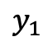
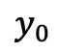
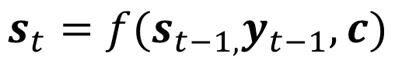
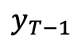
Decoder: another Recurrent Neural Network
Decode the output sequence y based on
the input sequence x
$$y_{0}$$
$$y_{1}$$
$$y_{T−1}$$
$$s_{t}=f(s_{t−1,}y_{t−1},c)$$
$$p\left(y_{t} | y_{t−1},y_{t−2},…, y_{1}, c\right)=g(s_{t},y_{t−1},c)$$

Slide 7
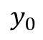
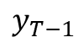
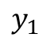
RNN Encoder-Decoder Issues
$$y_{0}$$
$$y_{1}$$
$$y_{T−1}$$

Slide 8
Attention-based Encoder-Decoder

Slide 9
New Encoder

Slide 10
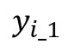
New Decoder
$$y_{i_1}$$

Slide 11
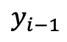
Alignment Model
$$y_{i−1}$$
Calculate context:

Slide 12

Output model
$$y_{i_1}$$
Previous output
Current context
current hidden state
Architecture: Fully connected + Maxout

Slide 13
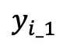
Update hidden state
$$y_{i_1}$$
Previous hidden state
Current context
Previous output
Architecture: GRU

Slide 14
Quantitative Results

Slide 15
Alignment between the Words

Slide 16
Attention Seq2Seq
https://github.com/bentrevett/pytorch-seq2seq/blob/master/3%20-%20Neural%20Machine%20Translation%20by%20Jointly%20Learning%20to%20Align%20and%20Translate.ipynb

Slide 17
Attention is All You Need

Slide 18
Sequence2Sequence (Encoder-Decoder)
$$y_{0}$$
$$y_{1}$$
$$y_{T−1}$$

Slide 19
Attention-Based Encoder-Decoder
$$y_{i_1}$$
Encoder
Attention-based Decoder

Slide 20
Limitations of Previous Seq2Seq Models
The encoders or decoders in the sequence to sequence models are generally implemented with recurrent neural networks
Sequential computation
Non-parallel

Slide 21
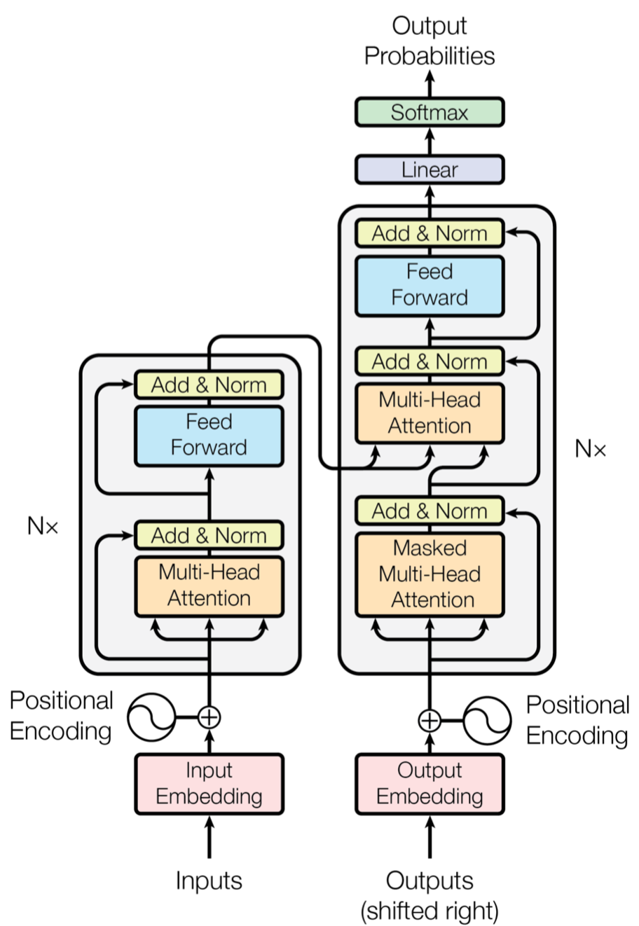
Attention is all you need (Vaswani et al. 2017)
The Transformer (Vaswani et al. 2017)
Only attention is used in both encoder and decoder
Parallelizable

Slide 22
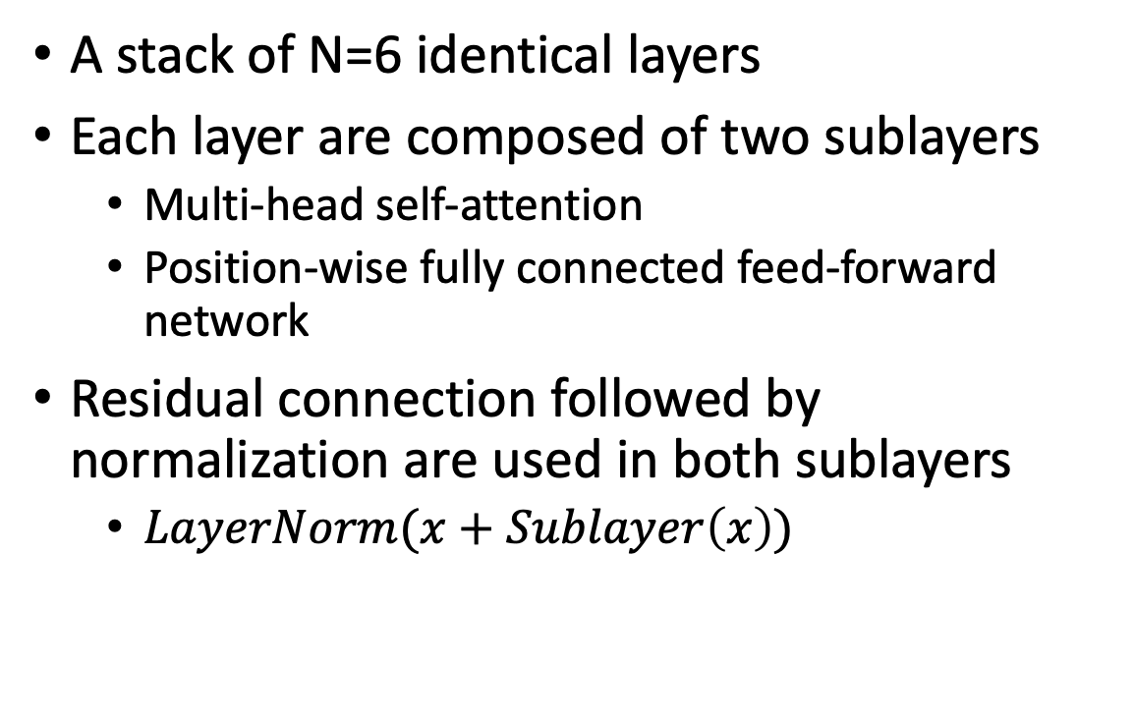
Encoder
A stack of N=6 identical layers
Each layer are composed of two sublayers
Multi-head self-attention
Position-wise fully connected feed-forward network
Residual connection followed by normalization are used in both sublayers
$LayerNorm(x+Sublayer\left(x\right))$

Slide 23
Multi-head Attention
Attention
Mapping a query and a set of key-value pairs to an output
Query, Keys, and Values are all vectors
The output is a weighted sum of the values, with the weights calculated according to a softmax function depending on the similarities between queries and keys

Slide 24
Multi-head Attention
Scaled Dot-Product Attention
Avoiding pushing the softmax function into regions where it has extremely small gradients.
d_k: dimension of keys and queries

Slide 25
Multi-head Attention
Multi-head Attention
Linearly project the queries, keys, and values h times with different, learned linear projects respectively
Concatenate the outputs and project again

Slide 26
Position-wise Feed-Forward Network
Applied to each position separately and identically
Two linear transformations with RELU as the activation in between
Different parameters are used across different layers

Slide 27
Positional Encoding
Without recurrence and convolution, the order information is lost
Need to encode the relative or absolute position of the tokens in the sequence
Position encodings are added to both the embeddings of the tokens in both encoder and decoder
Sine and cosine functions of different frequencies are used:
Pos is the position and i is the dimension

Slide 28
Decoder
N=6 identical layers
Each layer
Masked multi-head attention
Position-wise fully connected feed-forward network
Multi-head attention over the output of the encoder stack
Residual connection followed by normalization are used in all the three sublayers

Slide 29
Discussion: advantages of Self-Attention
Complexity
Short-range v.s. long-range dependency
Interpretability

Slide 30
Results

Slide 31
Thanks!

